Slide 1

Who’s the Boss of You?
Molly Gardner
Department of Philosophy
University of Florida

Slide 2
My Answer:
Not you!
More precisely, I will argue that you are not autonomous.

Slide 3

Anne, the “fake ceo”?
Anne believes that she is the boss of the company. Sometimes, Anne decides that the company should do something, and the company really does take that action. Other times, the company takes an action, and Anne decides after the fact that the company should take that action. There are yet other times when the company acts for one set of reasons, but when we ask Anne why they acted as they did, she offers completely different reasons.

Slide 4
My Argument:
(1) If Anne is not the boss of the company, then you are not the boss of you.
(2) Anne is not the boss of the company.
(3) Therefore, you are not the boss of you.

Slide 5
What Autonomy requires:
(1) Knowing what you are doing (or not doing).
(2) Knowing why you are doing it.

Slide 6
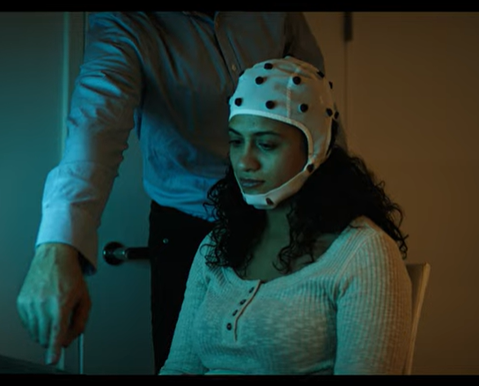
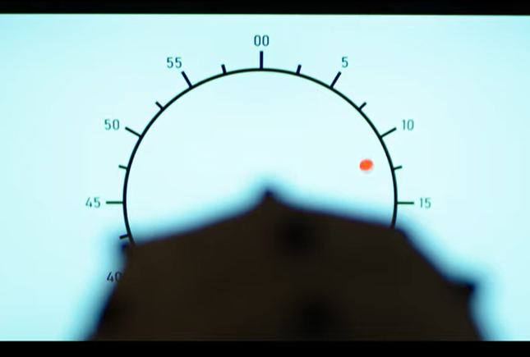
Evidence that you don’t know what you’re doing:
Libet et al. (1983)

Slide 7
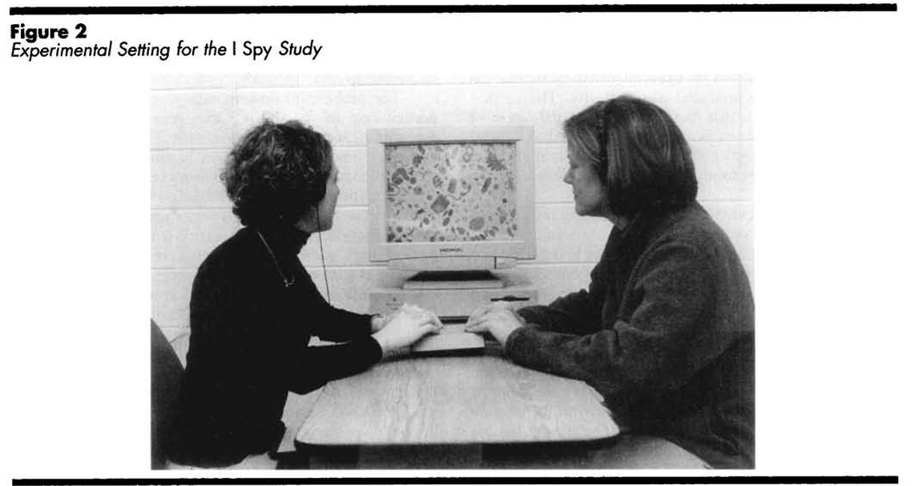
Evidence that you don’t know what you’re not doing:
Participants in the Wegner and Wheatley (1999) study rated their personal intention to stop on an object as higher when they had heard the name of the object 5 seconds or 1 second before they were forced to stop on it than when they heard the name 30 seconds before or 1 second after the forced stop.

Slide 8
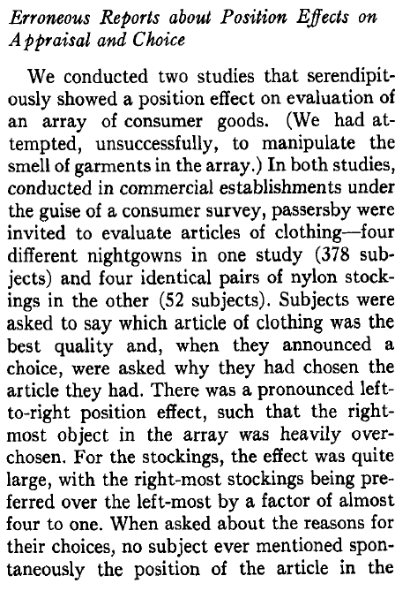
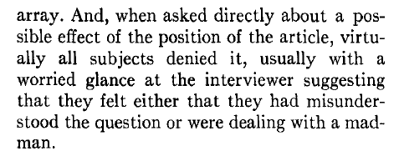
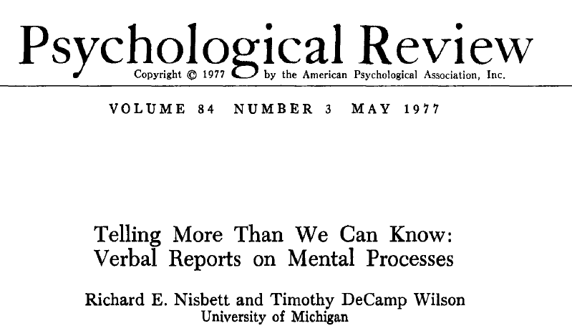
Evidence that you don’t know why you did what you did:

Slide 9
Evidence that you don’t know why you did what you did:
Isen and Levin (1972) observed subjects who had been using a phone booth in a suburban shopping plaza. As the subjects were exiting the phone booth, a confederate of the researchers walked by and dropped a folder full of papers. Isen and Levin found that the single variable that most accurately predicted whether the caller would stop to help collect the papers was whether the subject had found a dime that the researchers had placed in the phone’s coin slot before half of the trials. 88% who found the coin helped, whereas 4% who did not find the coin helped.
Researchers have also staged epileptic seizures, accidents, thefts, and illnesses in streets, stores, subways, and other locations. One variable that overwhelmingly predicts whether a witness to the scene will help is the number of other bystanders in the vicinity: as the number of other bystanders increases, the witness in question becomes less likely to help. In one of these studies by Latane and Rodin (1969), 70% of people who were alone helped, whereas 7% of people who were not alone helped.
Darley and Batson (1973). Two groups of seminary students were told that they would have to give a brief extemporaneous talk in a nearby building. Subjects in one condition were told to hurry because they were late, whereas subjects in the other condition were told that they had plenty of time to head over. On the way, subjects in both conditions passed a man who was slumped over, coughing and groaning. Only 10% of the late subjects stopped to help the man, but 63% of the early subjects helped.

Slide 10
My Argument:
(1) If Anne is not the boss of the company, then you are not the boss of you.
(2) Anne is not the boss of the company.
(3) Therefore, you are not the boss of you.

